Slide 1
Guide to Programming with Python
Chapter Three
Branching, while Loops, and Program Planning: The Guess My Number Game

Slide 2
Objectives
Generate random numbers
Use if structures to execute code based on a condition
Use if-else structures to make a choice based on a condition
Use if-elif-else structures to make a choice based on a series of conditions
Use while loops to repeat parts of a program
Plan programs
Guide to Programming with Python

Slide 3
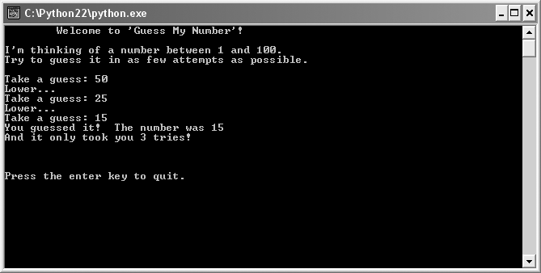
The Guess My Number Game
Figure 3.1: Sample run of the Guess My Number game
Got it in only three guesses! Try to beat that.
Guide to Programming with Python

Slide 4
Generating Random Numbers
Unpredictability adds excitement to games
Great for simulations
“Random” numbers generated by computer not truly random
Pseudorandom: generated by formula; complex but predictable pattern
Guide to Programming with Python

Slide 5
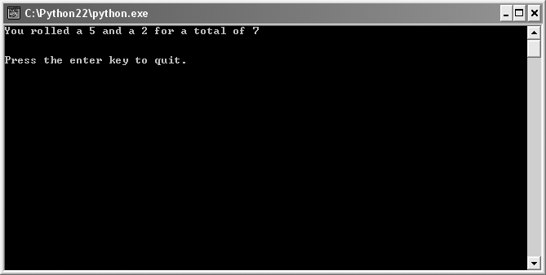
The Craps Roller Program
Figure 3.2: Sample run of the Craps Roller program
Ack! I got a total of seven on my first roll, which means I lose.
Guide to Programming with Python

Slide 6
randrange() Function
randrange() generates random number from range
If pass single integer n, randrange() returns random number from 0 to n - 1
randrange() part of random module
Module: file that contains code meant to be used in other programs
random is like a toolbox
randrange() is like a tool in the toolbox
Guide to Programming with Python

Slide 7
randrange() Function (continued)
Use import statement to gain access to a module
  import random
Now can access randrange() via random
  random.randrange(6) #returns random num 0 – 5
  dot notation: Convention used for accessing part of an object
    Like the possessive in English
    random.randrange() is like saying
    “The random module’s randrange() function”
Guide to Programming with Python

Slide 8
Using the if Structure
Branching: Program taking one path (or branch) of code instead of another
Through if structure, programs can branch to a section of code or skip it
Guide to Programming with Python

Slide 9
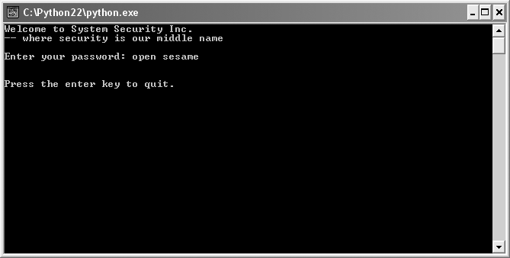
The Password Program
Figure 3.3: Sample run of the Password program
Ha, you’ll never crack the code.
Guide to Programming with Python

Slide 10
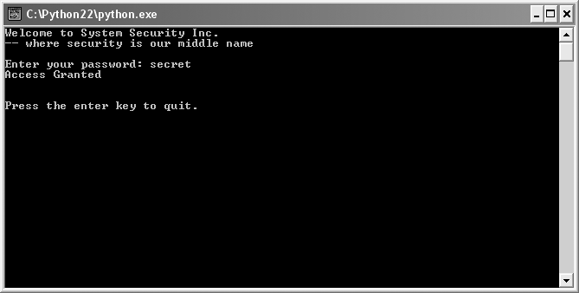
The Password Program (continued)
Figure 3.4: Sample run of the Password program
Guess I should have picked a better password than “secret.”
Guide to Programming with Python

Slide 11
Conditions
Condition: Expression that is True or False
True and False are values of type bool
password == "secret" is condition - True or False
  If variable password is equal to string "secret" condition evaluates to True
  Otherwise, condition evaluates to False
Often create conditions by comparing values
This is a ‘comparison ‘ operator!
Guide to Programming with Python

Slide 12
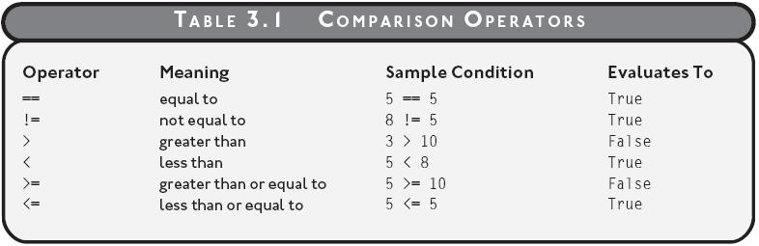

Comparison Operators
Table 3.1: Useful comparison operators
Guide to Programming with Python

Slide 13
The if Statement
  if password == "secret":
    print "Access Granted"
Branches based on a condition
Executes block of code that directly follows
If condition password == "secret" is True, "Access Granted" printed
Otherwise, print statement skipped
Guide to Programming with Python

Slide 14
Using the if-else Structure
May want program to “make a choice” based on a condition
  Do one thing if the condition is true
  Do something else if it’s false
if-else structure gives you that power
Guide to Programming with Python

Slide 15

The Granted or Denied Program
Figure 3.5: Sample run of the Granted or Denied program
The correct password grants the user access, just like before.
Guide to Programming with Python

Slide 16

The Granted or Denied Program (continued)
Figure 3.6: Sample run of the Granted or Denied program
An incorrect password generates the stinging “Denied” message.
Guide to Programming with Python

Slide 17
The else Clause
if password == "secret":
  print "Access Granted"
else:
  print "Access Denied"
Optional else clause defines block to be executed if condition False
If password == "secret" is False, then "Access Denied" printed
Guide to Programming with Python

Slide 18
Using the if-elif-else Structure
if-elif-else structure
  Allows program to choose from among several blocks to execute
  Often used to compare a single variable to a series of values
Guide to Programming with Python

Slide 19
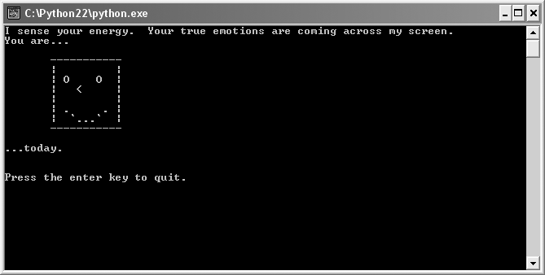
The Mood Computer Program
Figure 3.7: Sample run of the Mood Computer program
Looks like the user was in a great mood.
Guide to Programming with Python

Slide 20
The if-elif-else Structure
if mood == 0:
# happy
elif mood == 1:
# neutral
elif mood == 2:
# sad
else:
print "Illegal mood value!"
Guide to Programming with Python

Slide 21
The if-elif-else Structure (continued)
Tests a chain of conditions after if and elif (short for “else if”)
On first True condition, associated block executed and structure exited
If no conditions True, block following optional else clause executed
Guide to Programming with Python

Slide 22
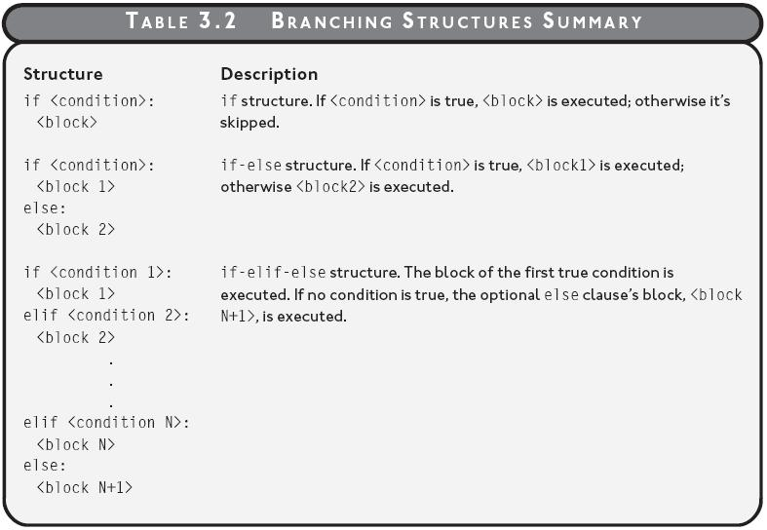

Branching Structures
Table 3.2: Branching structures summary
Guide to Programming with Python

Slide 23
Creating while Loops
while loop
  Allows you to repeat block of code
  Repetition based on a condition
Guide to Programming with Python

Slide 24
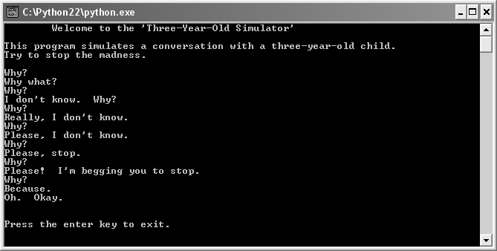
The Three-Year-Old Simulator Program
Figure 3.8: Sample run of Three-Year-Old Simulator program
If you’ve ever been in charge of a three-year-old…
Guide to Programming with Python

Slide 25
The while Loop
while response != "Because.":
  response = raw_input("Why? ")
Allows you to repeat section of code as long as some condition is True
Like if statement, in that it tests a condition and executes associate block if condition True
But, after block, repeats condition test; if condition still True, repeats block
Continues process until condition tests False
Guide to Programming with Python

Slide 26
The while Loop (continued)
Sentry variable: Variable used in loop condition
  response
Loop body: Block associated with loop
  response = raw_input("Why? ")
Infinite loop: A loop that will never end; considered a logical error
Guide to Programming with Python

Slide 27
Avoiding Infinite Loops
A type of infinite loop where sentry variable is never updated is easy to track down
But there are more insidious forms of the never-ending loop
Guide to Programming with Python

Slide 28
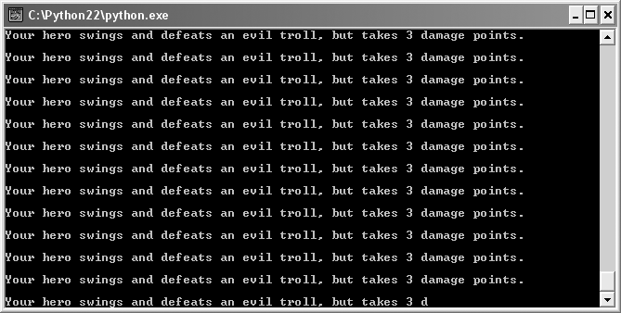
The Losing Battle Program
Figure 3.9: Sample run of the Losing Battle program
Example of an infinite loop
Guide to Programming with Python

Slide 29
Fixing an Infinite Loop
while health != 0:
  trolls += 1
  health = health – damage
Problem is condition is False only when health is exactly 0
Tracing: Examining the execution of a program and its internal values in single steps
Tracing shows that health becomes negative, but never exactly 0
Problem solved with new condition: health > 0
Guide to Programming with Python

Slide 30
Treating Values as Conditions
All values, not just True and False, can be treated as condition
So, 2749, 8.6, "banana", 0, and "" can each be interpreted as True or False
May seem confusing at first, but rules that determine True and False are simple
More importantly, interpreting values this way can make for more elegant conditions
Guide to Programming with Python

Slide 31
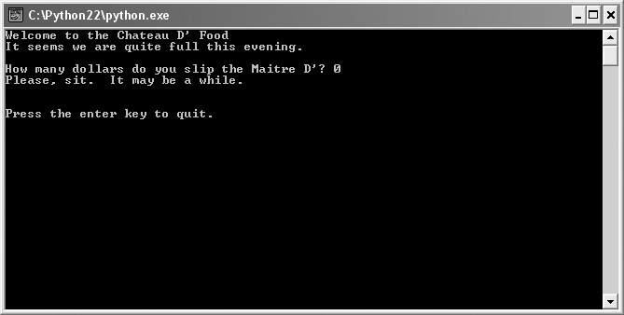
The Maitre D’ Program
Figure 3.11: Sample run of Maitre D’ Program
When you don’t tip the maitre d’, there are no tables to be found.
Guide to Programming with Python

Slide 32
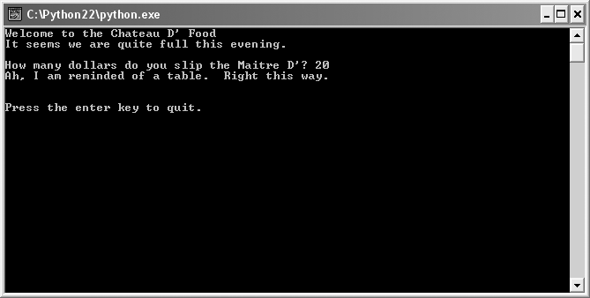
The Maitre D’ Program (continued)
Figure 3.12: Sample run of Maitre D’ Program
This time, some money has helped cure the maitre d’ of his amnesia.
Guide to Programming with Python

Slide 33
Interpreting Any Value as True or False
Any value can be interpreted as True or False when used as condition
  Any empty or zero value is False
    So, 0 and "" are False
  Any other value is True
    So for example, -10, 2.5, "banana" are True
if money:
  money is treated as condition
  True when money not 0; False when money is 0
Guide to Programming with Python

Slide 34
Creating Intentional Infinite Loops
“Intentional infinite” loop
  Has condition that’s always True
  But not truly infinite
  Written with an exit condition in loop body
  Sometimes cleaner to write than alternative loop
Guide to Programming with Python

Slide 35
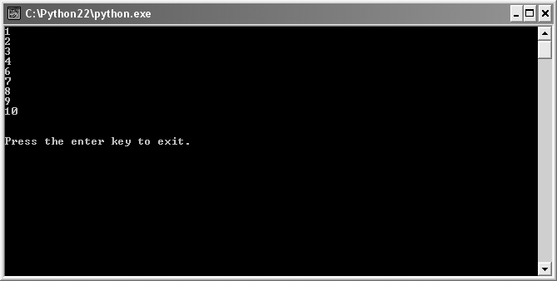
The Finicky Counter Program
Figure 3.13: Sample run of the Finicky Counter program
The loop demonstrates the continue and break statements.
Guide to Programming with Python

Slide 36
The break Statement
while True:
  count += 1
  # end loop if count is greater than 10
  if count > 10:
    break
while True: creates an “intentionally infinite” loop
  Must provide a way for loop to end
break causes a loop to end immediately
Create while True: loop if cleaner than alternative
Avoid break when possible, can lead to confusion
Guide to Programming with Python

Slide 37
The continue Statement
while True:
  count += 1
  # end loop if count is greater than 10
  if count > 10:
    break
  # skip 5
  if count == 5:
    continue
  print count
continue jumps to top of loop to check condition
Avoid when possible, can lead to confusion
Guide to Programming with Python

Slide 38
Using Compound Conditions
Can create more complex conditions by joining simple conditions seen so far with logical operators to create a compound condition
Simple condition: A simple form of a condition, such as a single comparison
Logical operator: An operator that joins conditions to form a large condition
Compound condition: A larger condition formed by joining simpler conditions
Guide to Programming with Python

Slide 39
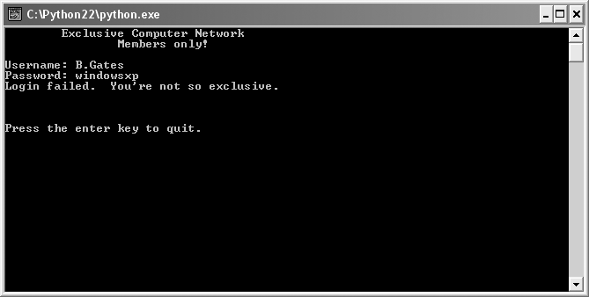
The Exclusive Network Program
Figure 3.14: Sample run of the Exclusive Network program
If you’re not a member or a guest, you can’t get in.
Guide to Programming with Python

Slide 40
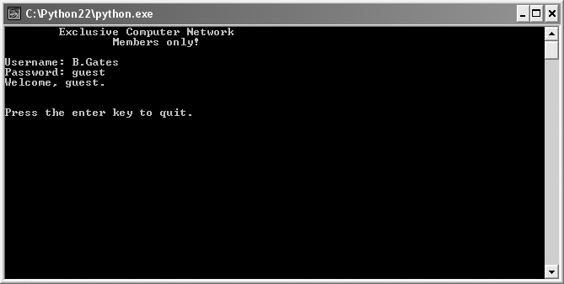
The Exclusive Network Program (continued)
Figure 3.15: Sample run of the Exclusive Network program
A guest can log in, but their security level is set quite low.
Guide to Programming with Python

Slide 41

The Exclusive Network Program (continued)
Figure 3.16: Sample run of the Exclusive Network program
Looks like one of the guys logged in today.
Guide to Programming with Python

Slide 42
The not Logical Operator
Evaluates to opposite
Like “not” in English
condition | not condition
True | False
False | True
Guide to Programming with Python

Slide 43
The not Logical Operator (continued)
username = ""
while not username:
  username = raw_input("Username: ")
not username is True while username equal to ""
while loop prompts until user enters something other than empty string
At that point, not username is False and loop ends
Guide to Programming with Python

Slide 44
The and Logical Operator
Like “and” in English, means both
True only if both conditions are True
condtion1 | condtion2 | condition1 and condition2
True | True | True
True | False | False
False | True | False
False | False | False
Guide to Programming with Python

Slide 45
The and Logical Operator (continued)
if username == "M.Dawson" and password == "secret":
  print "Hi, Mike."
Condition created by and is only True if both simpler conditions are True
So if both username is equal to "M.Dawson" and password is equal to "secret“, then greeting is displayed
Otherwise, it’s not displayed
Guide to Programming with Python

Slide 46
The or Logical Operator
condtion1 | condtion2 | condition1 or condition2
True | True | True
True | False | True
False | True | True
False | False | False
Like “or” in English, means either
True when either condition is True
Guide to Programming with Python

Slide 47
The or Logical Operator
elif username == "guest" or password == "guest":
  print "Welcome, guest."
Condition created by or is True when either simpler condition is True
So if either username is equal to "guest" or password is equal to "guest", then greeting is displayed
Otherwise, it’s not displayed
Guide to Programming with Python

Slide 48
Program Planning
Saves time (and heartache) later
Algorithm: Set of clear, easy-to-follow instructions for accomplishing some task
Stepwise refinement: Process used to rewrite algorithms in more detail so that they’re ready for implementation
Pseudocode: Outline of a program written in something between English and a programming language
Guide to Programming with Python

Slide 49
Algorithm in Pseudocode
The Make a Million Dollars Algorithm
if you can think of a new and useful product
  then that’s your product
otherwise
  repackage an existing product as your product
make an infomercial about your product
show the infomercial on TV
charge $100 per unit of your product
sell 10,000 units of your product
Guide to Programming with Python

Slide 50
Applying Stepwise Refinement
create an infomercial about your product
Becomes:
write a script for an infomercial about your product
rent a TV studio for a day
hire a production crew
hire an enthusiastic audience
film the infomercial
Guide to Programming with Python

Slide 51
Summary
A module is a file that contains code meant to be used in other programs
The import statement provides access to modules
The randrange() function from the random module generates a random number from a range
True and False are the values of type bool
A condition is an expression that is True or False
A block is a section of code indented to form a single unit
Guide to Programming with Python

Slide 52
Summary (continued)
The if statement executes a block of code when a condition is True
The optional else clause defines block to be executed when the condition is False
The if-elif-else structure tests a series of conditions to execute a single block of code
The while loop repeats a block of code as long as a condition is True
Any value can be interpreted as True or False when used as condition
Guide to Programming with Python

Slide 53
Summary (continued)
The break statement causes a loop to end immediately while the continue statement jumps control to top of loop
The not logical operator produces new condition that’s opposite value of original
The and logical operator creates new condition that’s only True if both simpler conditions are True
The or logical operator creates new condition that’s only True if either simpler condition is True
Program planning saves time and heartache
Guide to Programming with Python

